Slide 1



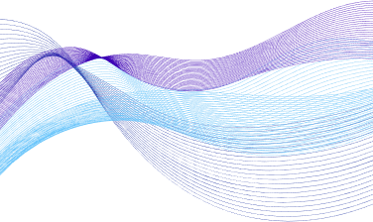

KubeSecure
AI-Driven Anomaly Detection in Kubernetes Cluster
Muhammad Hani
I21-2595
M. Usman Azam I21-0653
Dr. Arshad Islam
Supervisor
Daniyal Ahmad
I21-2493

Slide 2

Project Overview
Monitoring Challenges
01
Sophisticated Threats
02
In-Time Network Anomaly Detection
03
Automated Response Mechanism
04
YAML Misconfiguration Detection
05

Slide 3
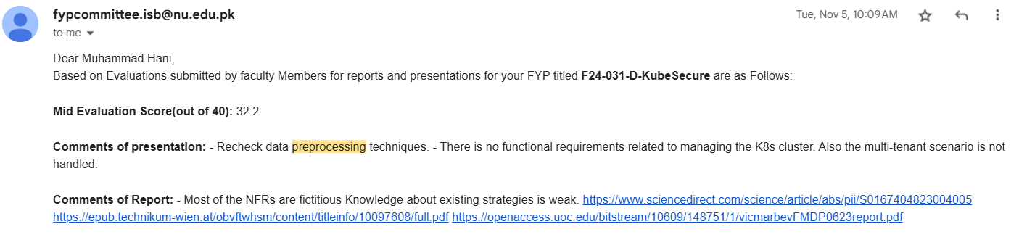
Mid Evaluation Feedback

Slide 4
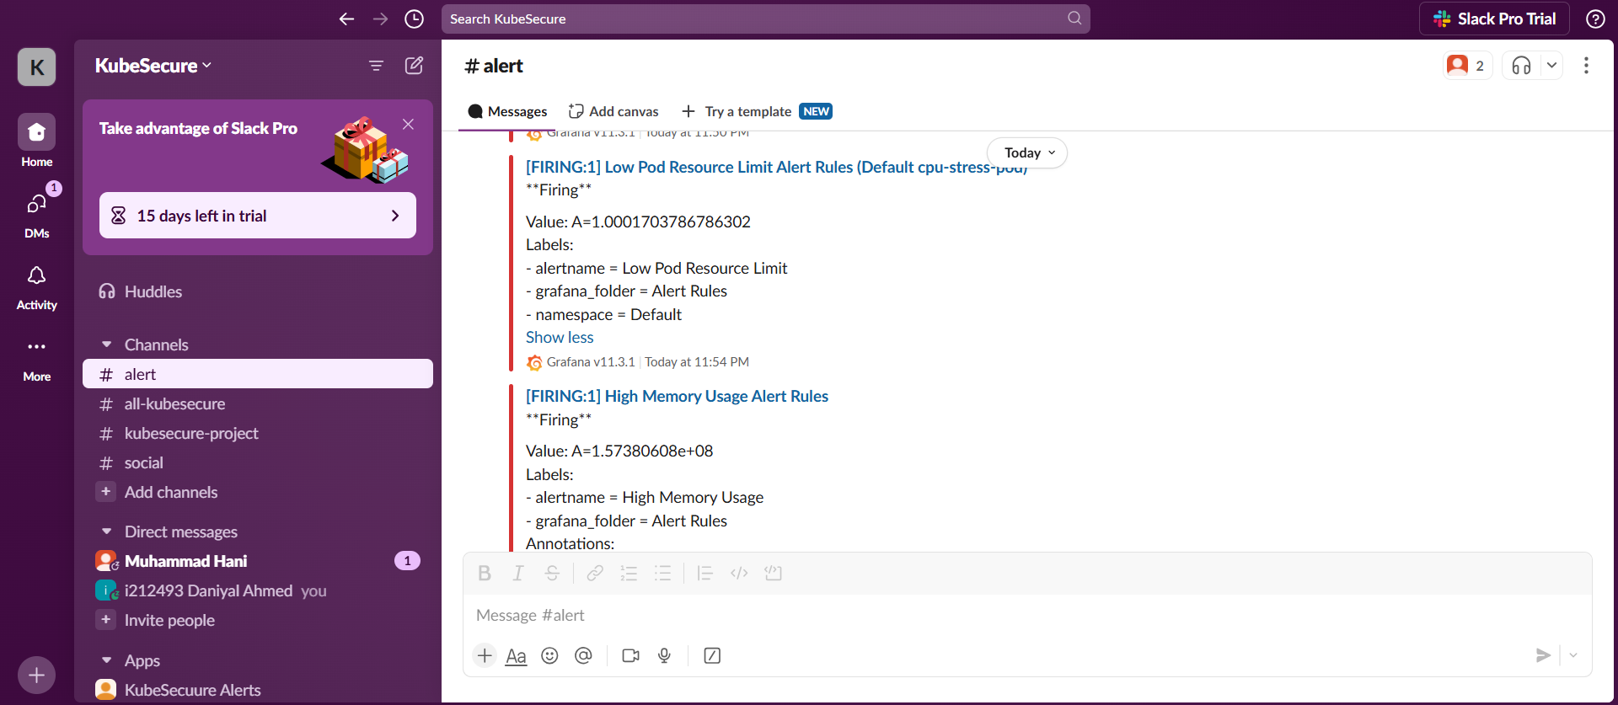
Grafana Alerts

Slide 5
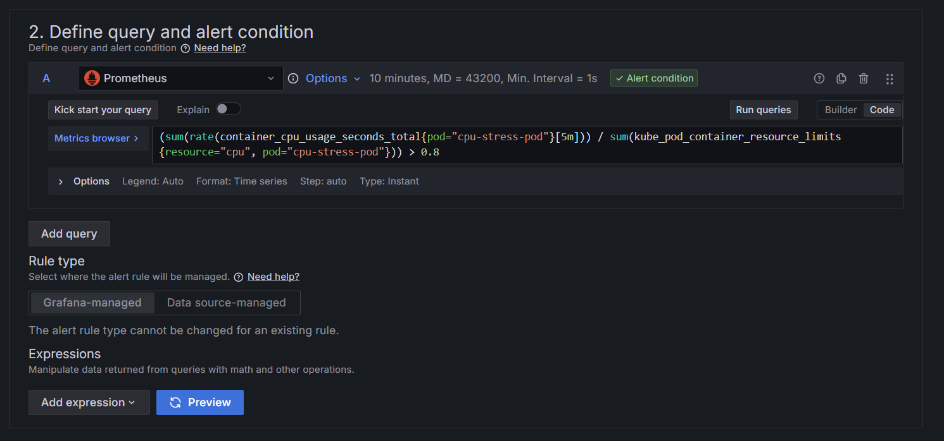
Grafana Alert Query

Slide 6
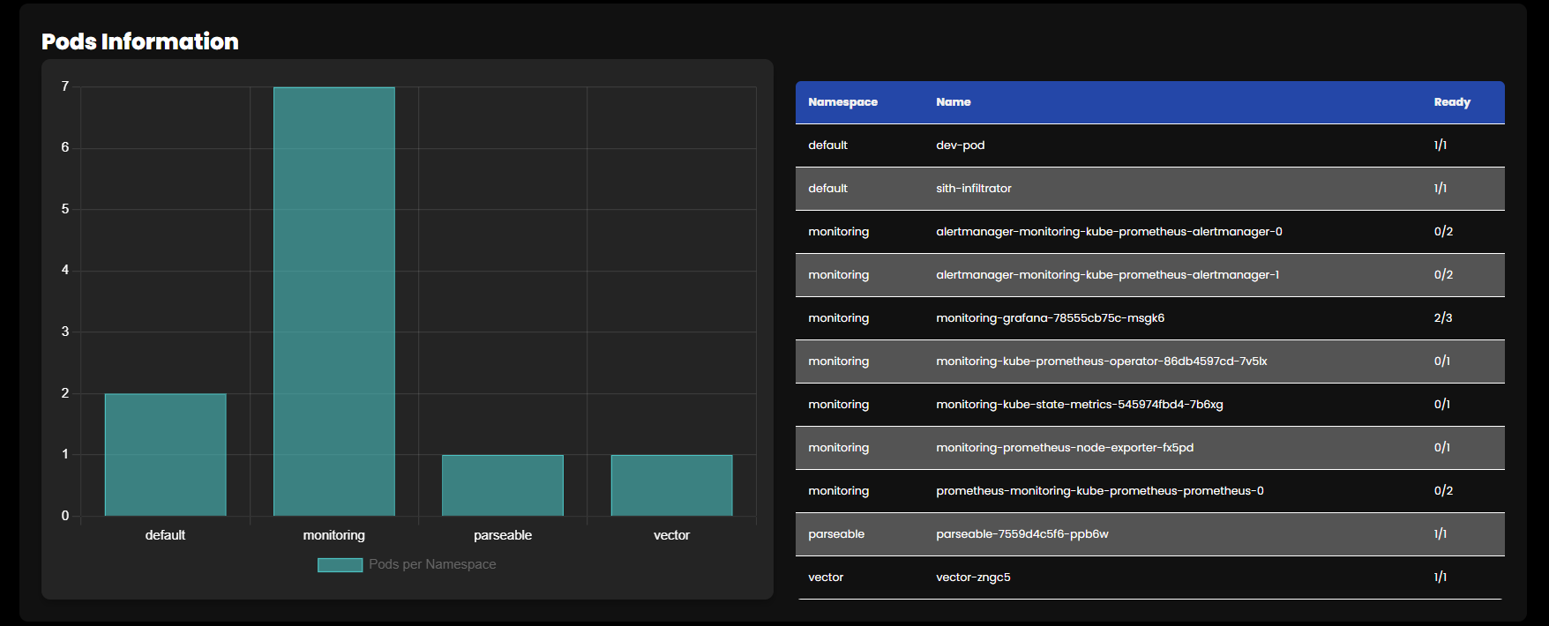
General Pods Status

Slide 7

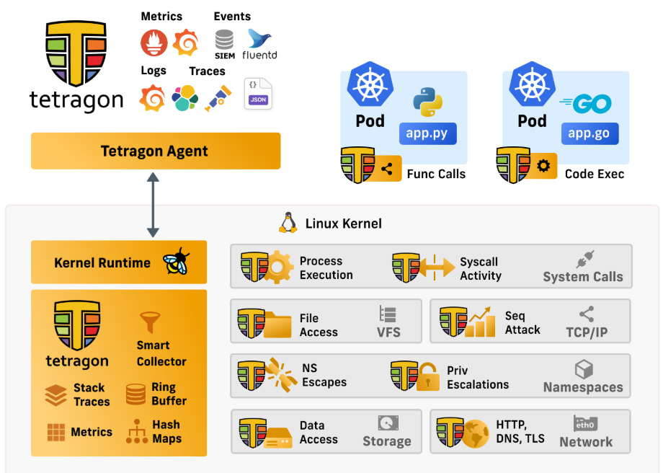
Tetragon
Tetragon leverages eBPF technology to provide enforcement, and visibility into network, application, and system-level events in Kubernetes clusters.
Can cater namespace escapes, privilege escalation, file system attacks and many more

Slide 8
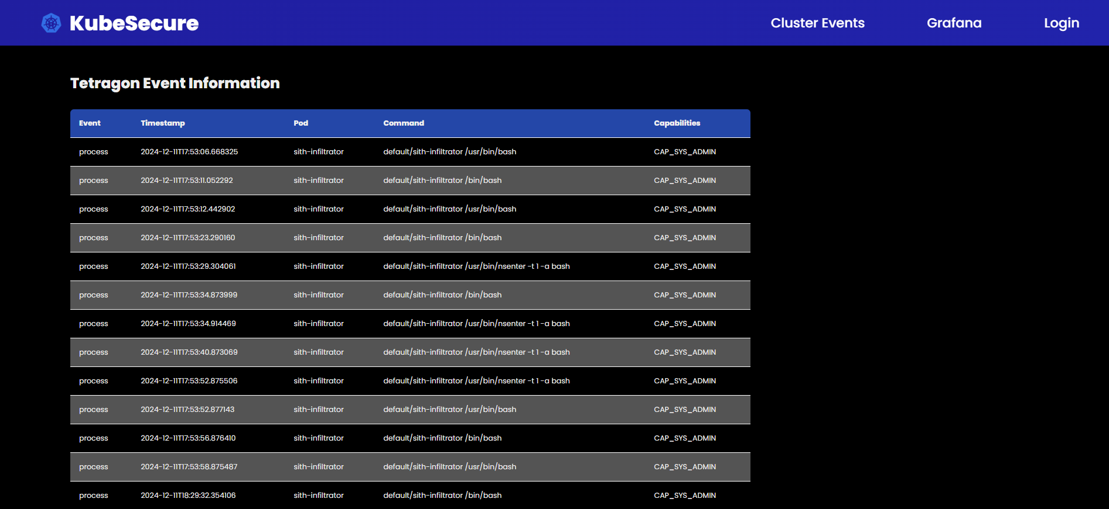
Tetragon Events

Slide 9
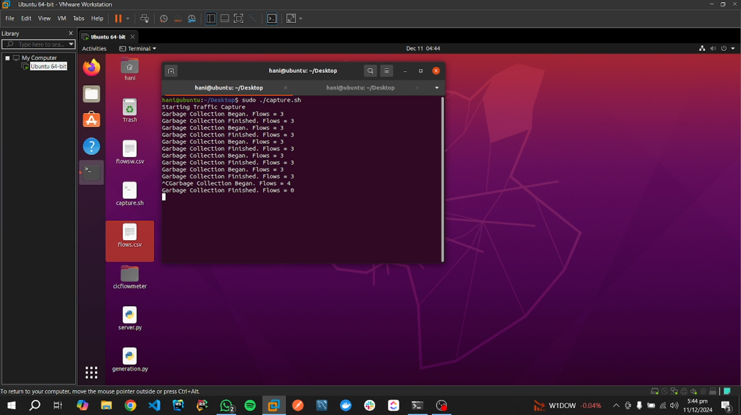
Traffic Mirroring

Slide 10
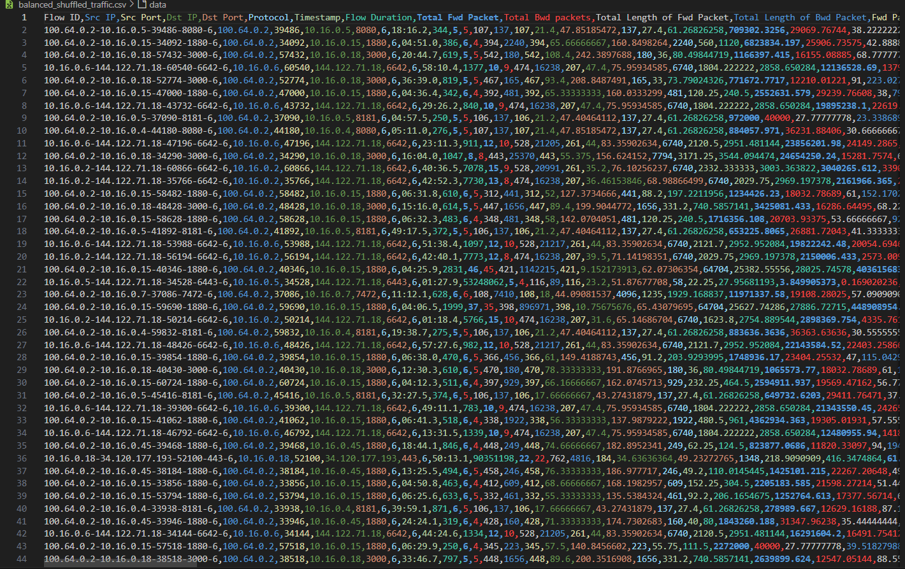
Dataset
1. Benign Folder (4 csv’s)
2. Malicious Folder (10 csv’s)
Reference
https://github.com/yigitsever/kubernetes-dataset?tab=readme-ov-file

Slide 11
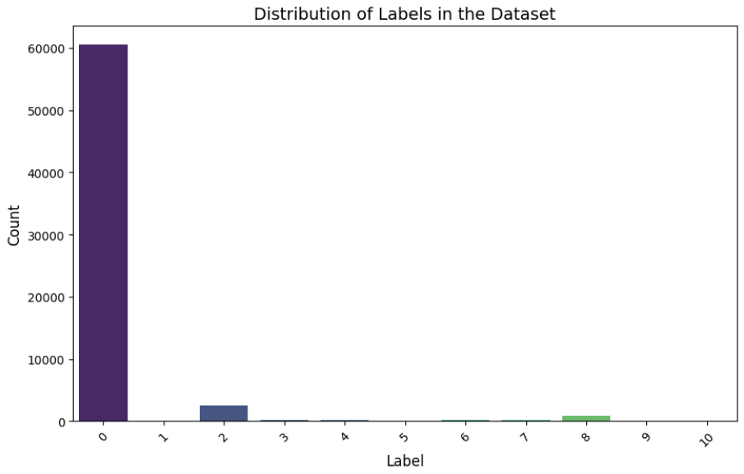
Analysis

Slide 12
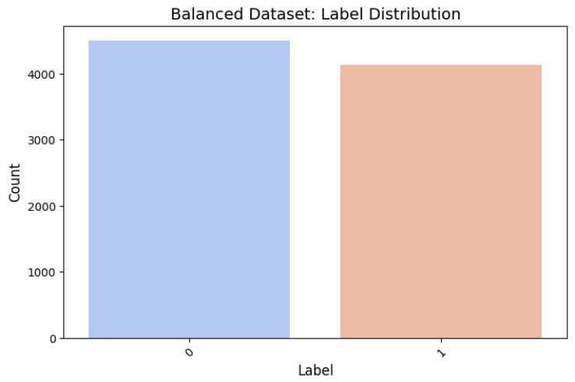
Modifications

Slide 13
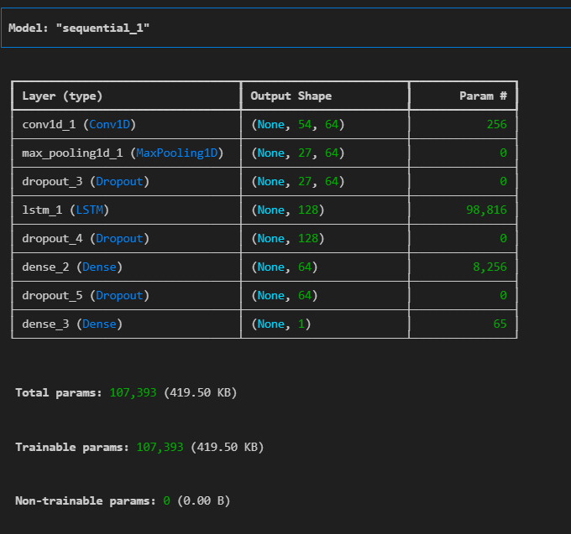
Model Selection
CLSTM (Convolutional LSTM)
Spatial Features (CNN Component)
Correlation between packet sizes, flow duration, and traffic volume
Temporal Features (LSTM Component)
Sequential Dependencies
Capturing Trends

Slide 14
Next Iterations
Model Integration and Final Testing
Automated Threat Mitigation
Cilium Integration and Rule Writing
Yaml File Misconfiguration Detection
Deployment

Slide 15
Thank You
Live Demo

